Slide 1


Rewriting history:
Changing the archived web from the present
Thinking like a hacker:
Security Considerations for High-Fidelity Web Archives
Ada Lerner, Tadayoshi Kohno, Franziska Roesner
ACM CCS 2017
Jack Cushman, Ilya Kreyemer
Perma.cc, Webrecorder
Presented By:
Sivakanesan Dhanushkanda
PhD Student
Department of Computer Science
Old Dominion University, Norfolk, Virginia
@siva_skanda
Created as a course requirement for CS895 Web Archiving Forensics (by Dr.Michael L. Nelson), Fall 2022

Slide 2
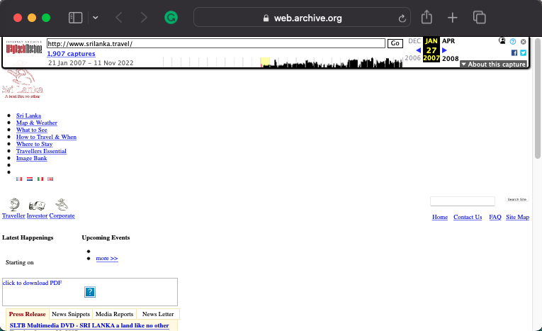
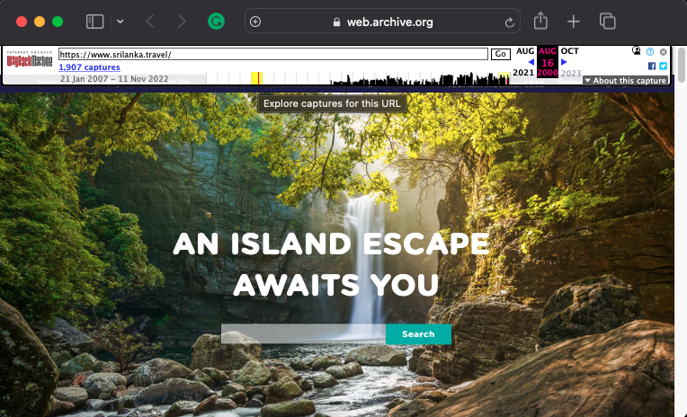
Web Archives: Replay web pages from the past
Since 1996
More than 760 billion web pages
https://web.archive.org/web/20070127055730/http://www.srilanka.travel/
https://web.archive.org/web/20220916073455/https://www.srilanka.travel/

Slide 3
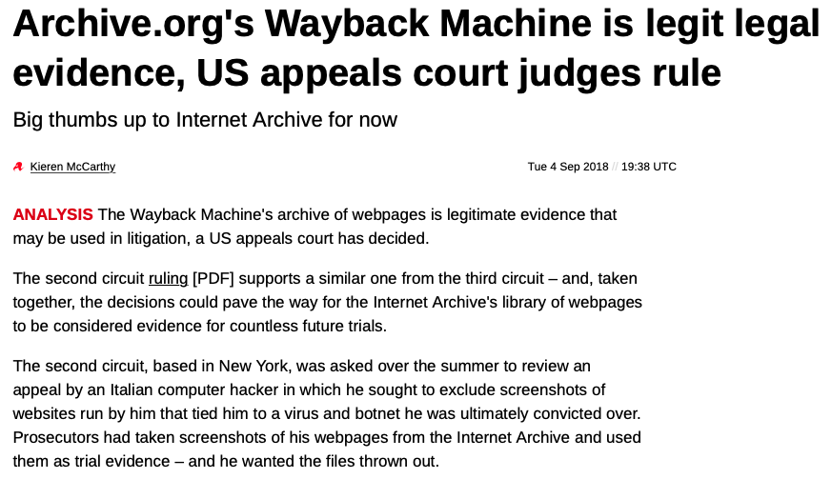
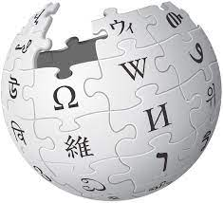
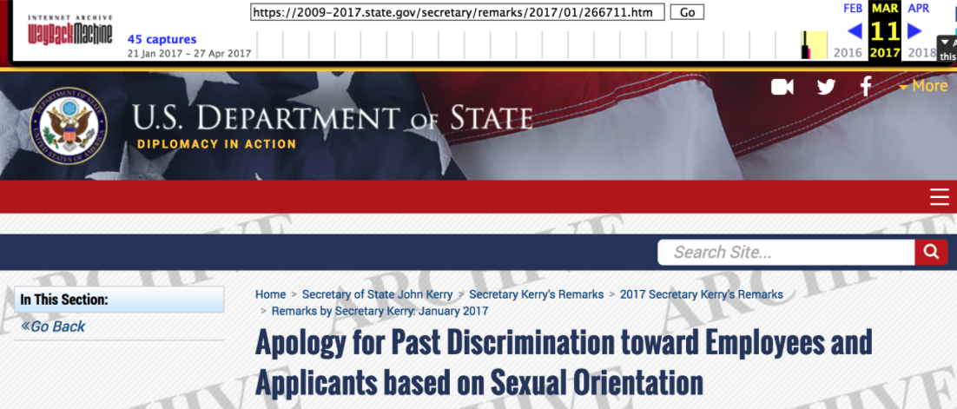
Web Archives are not just used to see how a webpage looked like in the past
Journalism
Changes in Government pages
Citations
Scientists: snapshots to increase durability of papers
Wikipedia: 14% of references to Wayback Machine
Legal proceedings
Use snapshots as evidence in civil and criminal cases
Patent applications
https://www.theregister.com/2018/09/04/wayback_machine_legit/
Lerner, Rewriting history, Nov 2017, Slideshow
https://github.com/phonedude/cs595-s22/blob/main/slides/Lerner-ACM-CCS-2017.pdf

Slide 4
Web Archives are not just used to see how a webpage looked like in the past
Journalism
Changes in Government pages
Citations
Scientists: snapshots to increase durability of papers
Wikipedia: 14% of references to Wayback Machine
Legal proceedings
Use snapshots as evidence in civil and criminal cases
Patent applications
https://www.theregister.com/2018/09/04/wayback_machine_legit/
Can Web Archives be manipulated?
HOW?
Lerner, Rewriting history, Nov 2017, Slideshow
https://github.com/phonedude/cs595-s22/blob/main/slides/Lerner-ACM-CCS-2017.pdf

Slide 5



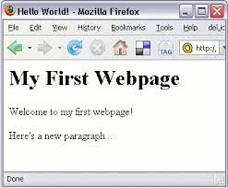
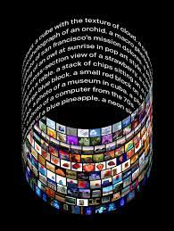
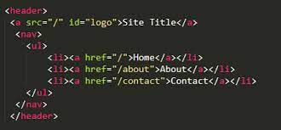
Why should we look at Web Archives from a
security perspective?

Slide 6

Why should we look at Web Archives from a
security perspective?
Host A
Host B
WayBack machine
Evil.com in same origin can mount its attack

Slide 7
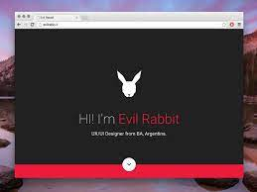

Why should we look at Web Archives from a
security perspective?
Host A
Host B
WayBack machine
Evil.com in same origin can mount its attack
WayBack machine

Slide 8
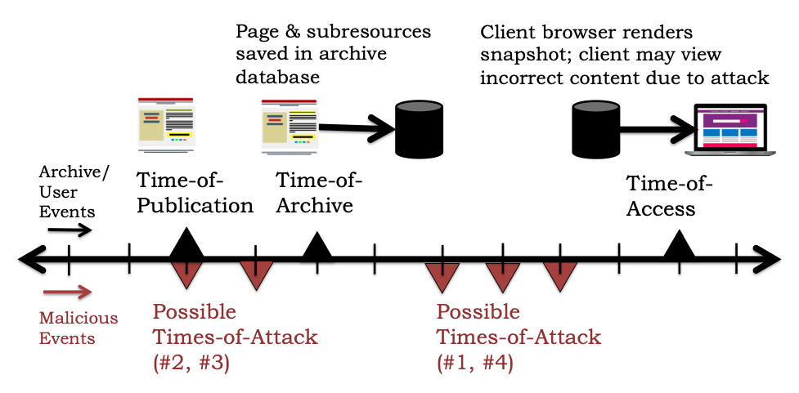
Threat model
Fig 2, Lerner et al. 2017

Slide 9
Threat model
Lifecycle of archive snapshots
Events that make up the attacks
Fig 2, Lerner et al. 2017

Slide 10
Threat model
Lifecycle of archive snapshots
GOAL: Change what clients see when they view archived snapshots
Events that make up the attacks
Fig 2, Lerner et al. 2017

Slide 11
Possible attacks
Archive-Escapes
Anachronism Injection
Same-Origin Escapes
Never-Archived Resources and Nearest-Neighbor Timestamp Matching

Slide 12
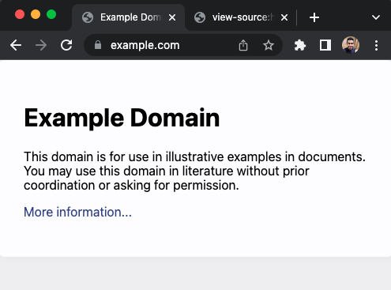
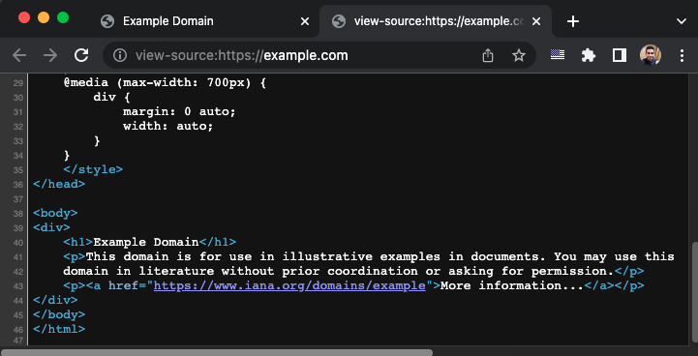
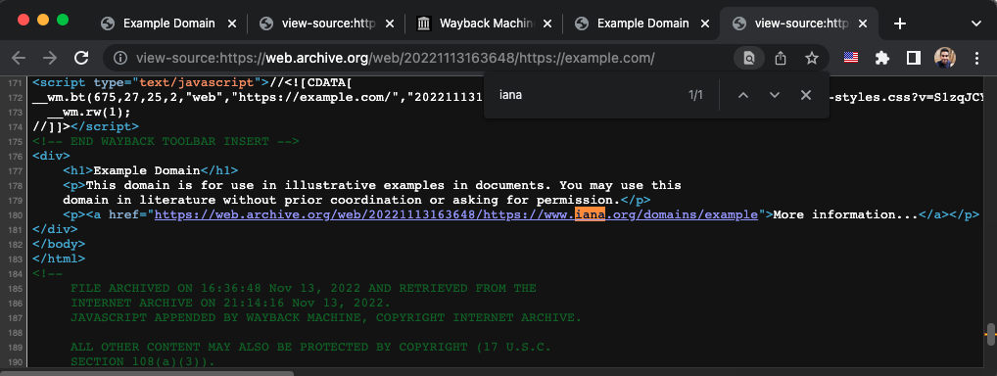
Re-writing URLs
Live page
Archived page

Slide 13
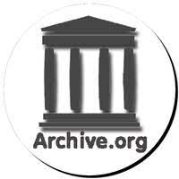

Archive-Escapes
<script src=”web.archive.org/20110130214521/example.com/script.js”>
Normal archived requests
(URLs successfully rewritten)
<script src=”example.com/script.js”>
Client renders mix of live and archived content
example.com
Archive-Escape requests (example.com is the destination)

Slide 14
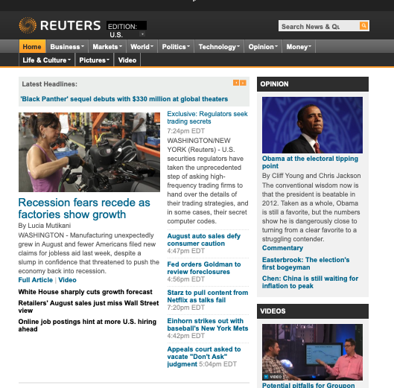
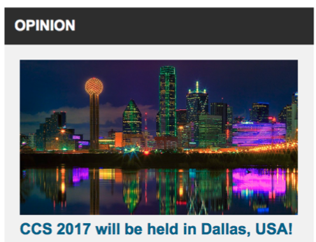
reuters.com showing articles in the future
Live-web zombies
https://ws-dl.blogspot.com/2012/10/2012-10-10-zombies-in-archives.html
https://web.archive.org/web/20110901233330/http://www.reuters.com/

Slide 15
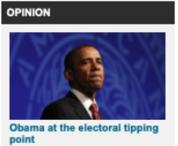
reuters.com showing articles in the future
Active attack
https://web.archive.org/web/20110901233330/http://www.reuters.com/

Slide 16
Attack #1: Archive-Escape Abuse
https://web.archive.org/web/20110901233330/http://www.reuters.com/

Slide 17
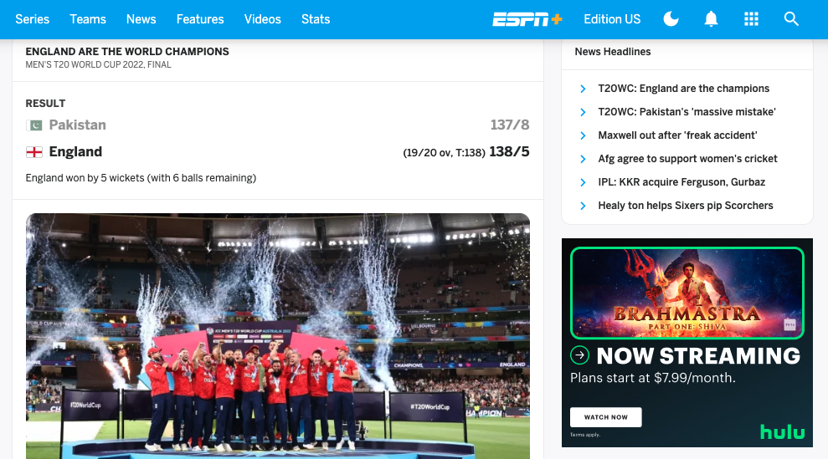
Same-Origin Escapes
iframe

Slide 18
Same-Origin Escapes

Slide 19


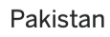
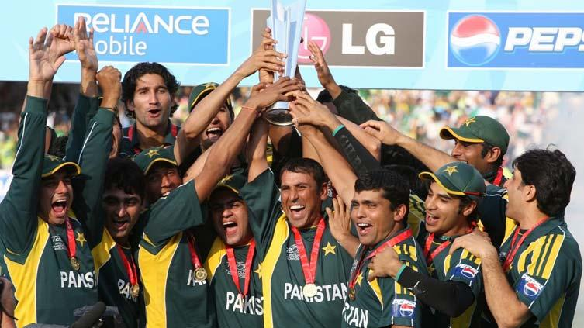
Attack #2: Same-Origin Escape Abuse
PAKISTAN ARE THE WORLD CHAMPIONS
Passive attack

Slide 20
Attack #3: “Same-Origin Escape” +
“Archive-Escape Abuse”
Attacker embeds an archive-escape URL as src attribute of <script> tag in <iframe>
Page, <iframe> archived
Attacker embedded as an <iframe>
Attacker publishes payload at the archive-escape <iframe>
Client loads page
<iframe> retrieved from archive
Script causes an archive-escape
Browser retrieves payload and executes in <iframe>
<iframe> in same origin, attack commences

Slide 21
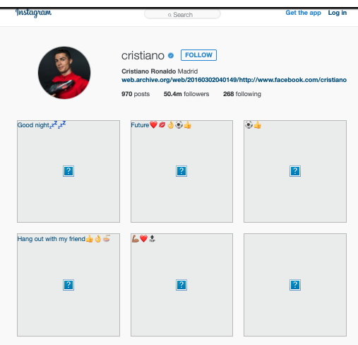
Archived captures sometimes miss necessary resources to replay
Missing images
Archival crawler errors
Partial unavailability of the web server at the time-of-archival
https://web.archive.org/web/20160302040149/https://www.instagram.com/cristiano/

Slide 22
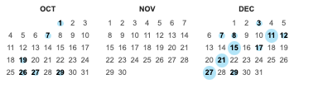
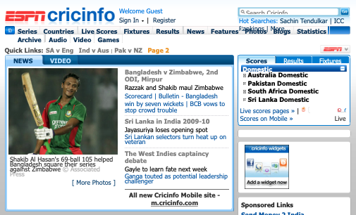
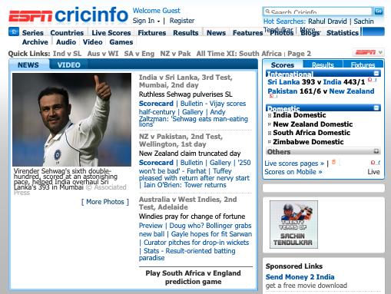
We do not always get a snapshot for a specific timestamp we needed
https://web.archive.org/web/20091029223145/http://www.cricinfo.com/
https://web.archive.org/web/20091203121939/http://www.cricinfo.com/

Slide 23
We do not always get a snapshot for a specific timestamp we needed
Anachronisms
https://web.archive.org/web/20091029223145/http://www.cricinfo.com/
https://web.archive.org/web/20091203121939/http://www.cricinfo.com/

Slide 24
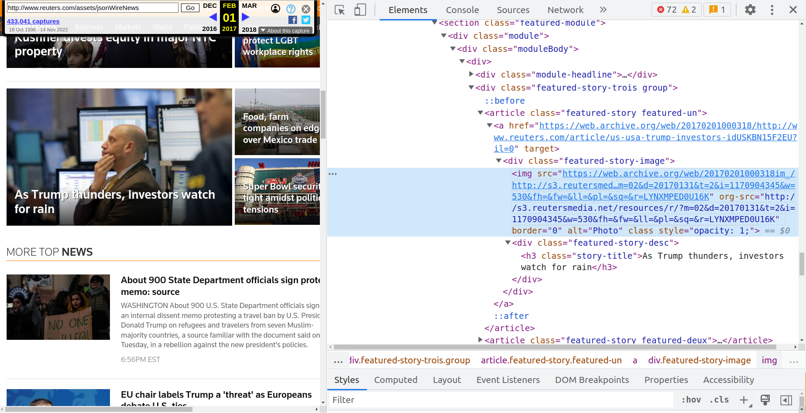
The source URL for the embedded image is re-written in the HTML

Slide 25
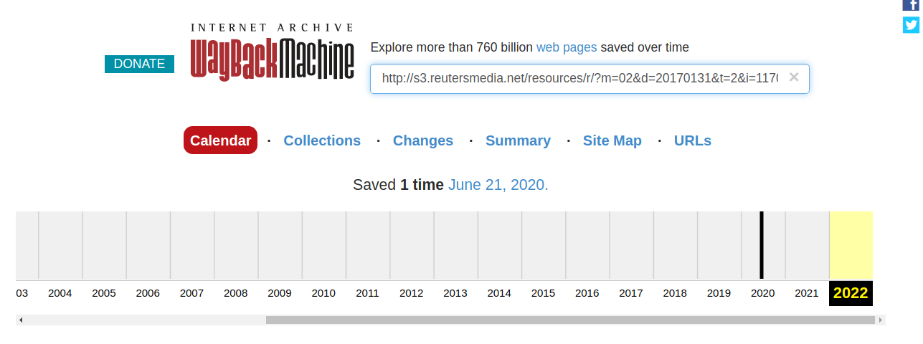
The image URL is only archived once till today
https://web.archive.org/web/*/http://s3.reutersmedia.net/resources/r/?m=02&d=20170131&t=2&i=1170904345&w=530&fh=&fw=&ll=&pl=&sq=&r=LYNXMPED0U16K

Slide 26
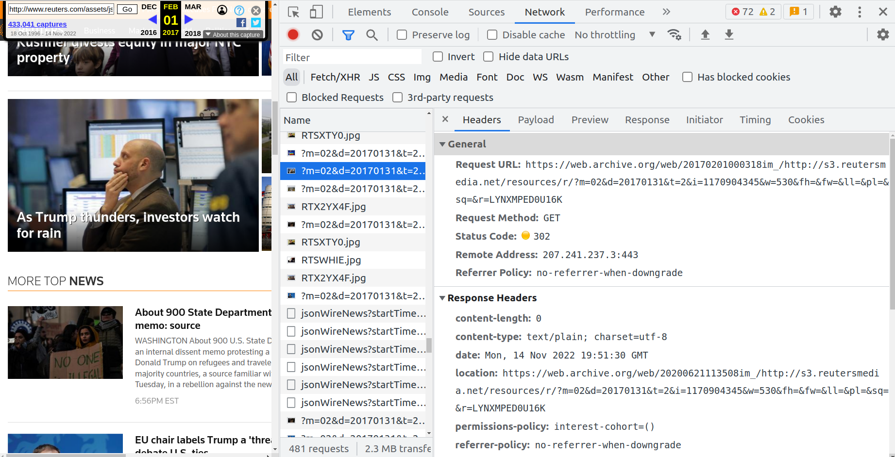
The request is redirected to the nearest available capture of the resource at the resolution time
https://web.archive.org/web/20200621113508im_/http://s3.reutersmedia.net/resources/r/?m=02&d=20170131&t=2&i=1170904345&w=530&fh=&fw=&ll=&pl=&sq=&r=LYNXMPED0U16K

Slide 27

Attack #4: Anachronism Injection
Precondition: vulnerable snapshot contains reference to never-archived resources
https://web.archive.org/web/19960101/http://example.com/image.png
archive.org
404 Not Found
example.com

Slide 28
Attack #4: Anachronism Injection
Precondition: vulnerable snapshot contains reference to never-archived resources
https://web.archive.org/web/20221114/http://example.com/image.png
https://web.archive.org/web/19960101/http://example.com/image.png
archive.org
404 Not Found
“Save Page Now”
Only capture of missing resource
example.com
Crafts malicious code, host in web server
example.com/image.png

Slide 29
Attack #4: Anachronism Injection
Precondition: vulnerable snapshot contains reference to never-archived resources
https://web.archive.org/web/20221114/http://example.com/image.png
https://web.archive.org/web/19960101/http://example.com/image.png
archive.org
404 Not Found
2022 version is available!
“Save Page Now”
Only capture of missing resource
Client requests the vulnerable source
Nearest neighbor timestamp matching redirects to the anachronistic malicious content
example.com
Crafts malicious code, host in web server
example.com/image.png

Slide 30
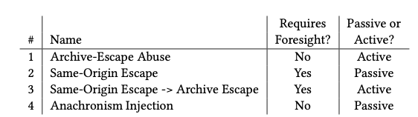
Reflecting on attacks
Table 1, Lerner et al. 2017

Slide 31
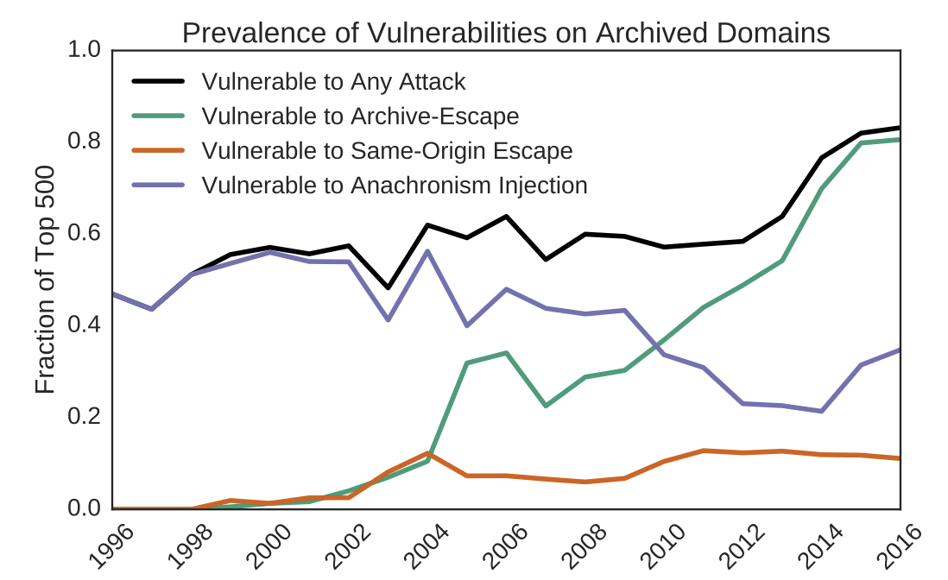
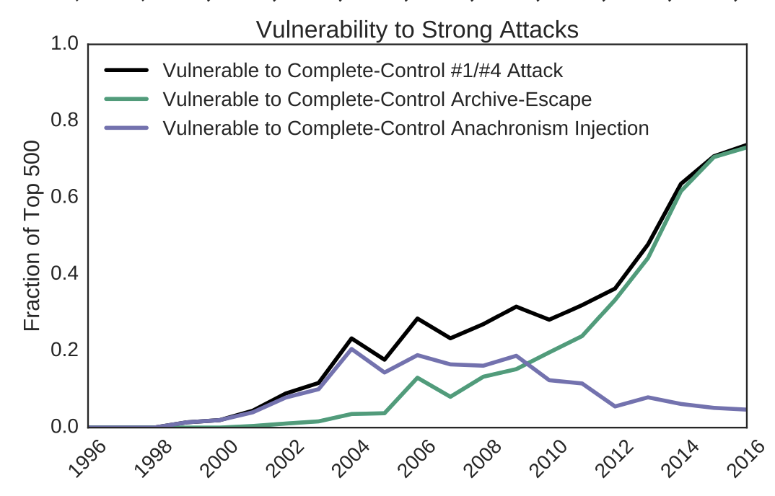
Three-Fourths of Archived sites are vulnerable
Fig 3, Lerner et al. 2017

Slide 32
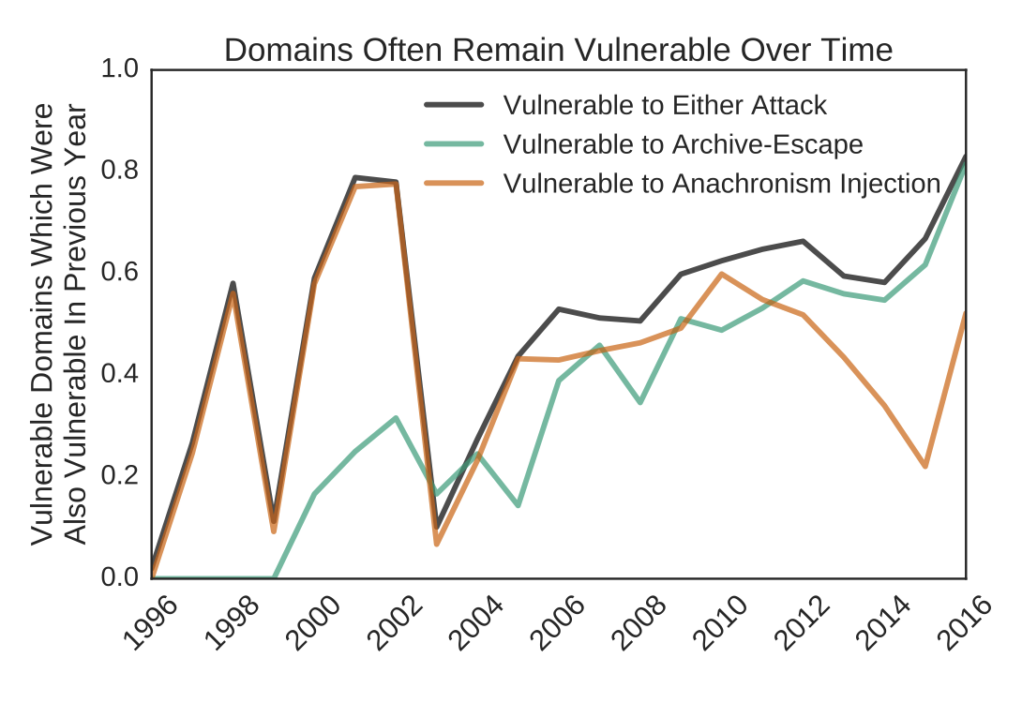
Domains remain vulnerable over archival time
Of all Domains vulnerable to archive-escape abuse in 2016
80% were also vulnerable in 2015
Fig 4, Lerner et al. 2017

Slide 33
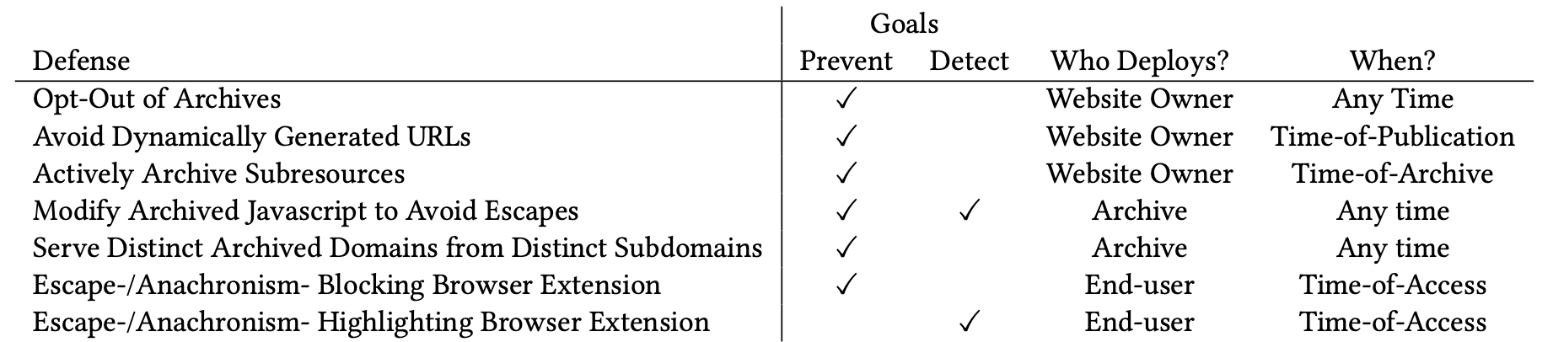
Defenses
Table 3, Lerner et al. 2017
ArchiveWatcher: A chrome extension used to detect and block archive-escape request vulnerabilities

Slide 34
Defenses
Table 3, Lerner et al. 2017
ArchiveWatcher: A chrome extension used to detect and block archive-escape request vulnerabilities

Slide 35
Defenses
Table 3, Lerner et al. 2017
ArchiveWatcher: A chrome extension used to detect and block archive-escape request vulnerabilities

Slide 36
Defenses
Table 3, Lerner et al. 2017
ArchiveWatcher: A chrome extension used to detect and block archive-escape request vulnerabilities

Slide 37
Defenses
Table 3, Lerner et al. 2017
ArchiveWatcher: A chrome extension used to detect and block archive-escape request vulnerabilities

Slide 38
Defenses
Table 3, Lerner et al. 2017
ArchiveWatcher: A chrome extension used to detect and block archive-escape request vulnerabilities

Slide 39
Possible security threats discussed by Cushman and Kreymer
Archiving local server files
Hacking the headless browser
Stealing user secrets during capture
Cross site scripting to steal archive logins
Live web leakage on playback
Show different page contents when archived
Banner spoofing

Slide 40
Archiving local server files could capture private resources into a public archive
Private resources archived and available to public
Local ports: http://localhost:8080/
Network server: http://private-server/
Local files: file:/etc/passwd
Source: Thinking like a hacker: Security Considerations for High-Fidelity Web Archives
Mitigation:
Prevent capturing local IP ranges (e.g. 10.0.0.0-10.255.255.255)
Only HTTP/HTTPS
Sandboxing

Slide 41
Exploitation of the headless browsers
Captures may use PhantomJS or other browsers on the server
There are known vulnerabilities in many browsers
Pages being crawled can exploit them
Mitigation:
Run capture system in isolated virtual machine (VM) - Sandboxing
Keep VM up to date

Slide 42
Stealing Login Info during capture
Webpages embedding iframes do not interact with each other
Same Origin Policy
https://facebook.com/login
https://ads.com/evil.js
During a Conifer (formerly Webrecorder) interactive capture:
https://conifer.rhizome.org/skandasiva/default-collection/45jvak5crkmr4qq7/record/$br:chrome:76/https://www.facebook.com/
https://conifer.rhizome.org/skandasiva/default-collection/59fhhdmn4kksnx2/record/$br:chrome:76/https://ads.com/evil.js
Mitigation:
Rewrite cookies to exact path only (partial mitigation)
Rewrite JS to intercept cookie access (partial mitigation)
For Webrecorder, use separate recording sessions when recording credentialed content (partial)
Record in containerized/proxy mode browser

Slide 43
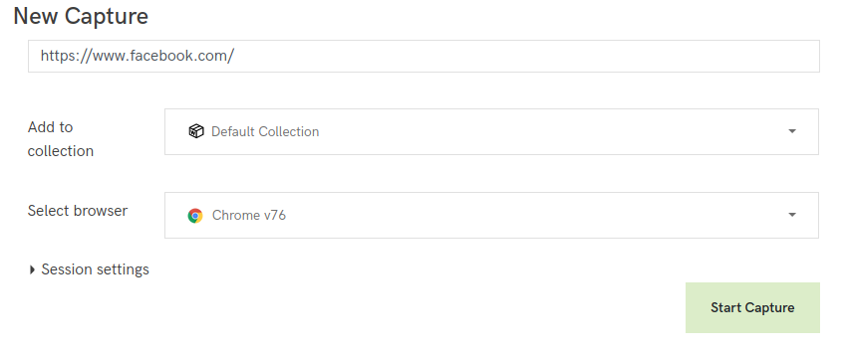
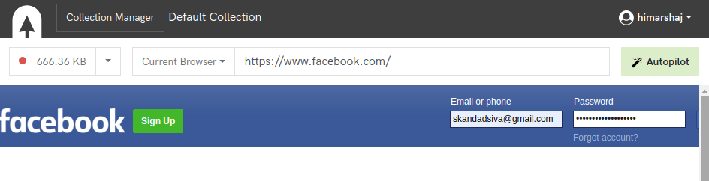
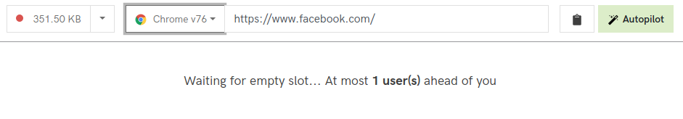
Capturing a web page via Conifer
Go to https://conifer.rhizome.org/
Create an account
https://conifer.rhizome.org/{account_name}
Capture a web page as browser sessions (requests sent by the browser and responses from the web are captured while you are interacting with sites)
https://conifer.rhizome.org/{account_name}/default-collection/45jvak5crkmr4qq7/record/$br:chrome:76/https://www.facebook.com/

Slide 44
Cross site scripting to steal archive logins
Across domains:
https://myarchive.com/login is the main institution login page
http://myarchive.com/web/http://evil.com is a web archive
Source: Thinking like a hacker: Security Considerations for High-Fidelity Web Archives
Across subdomains:
https://archive.org/account/login is the main institution login page
https://web.archive.org//http://evil.com is a web archive
Mitigation:
Use iframes to isolate web archive content
Load web archive app from app domain
Load iframe content from content domain
Perma.cc example:
https://perma.cc/ -- app domain
https://perma-archives.org/ -- content domain

Slide 45
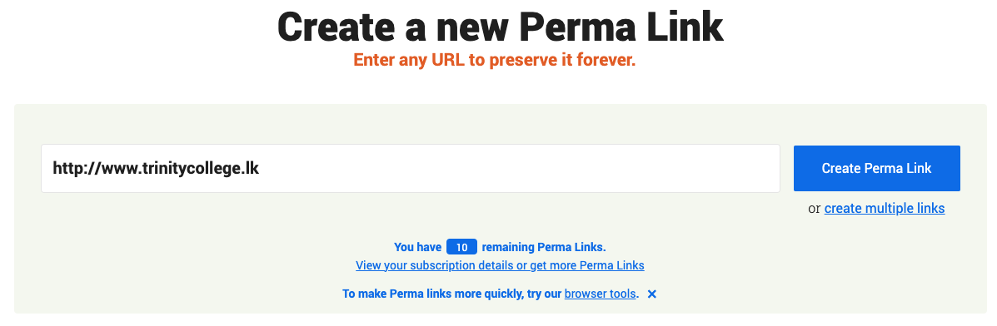
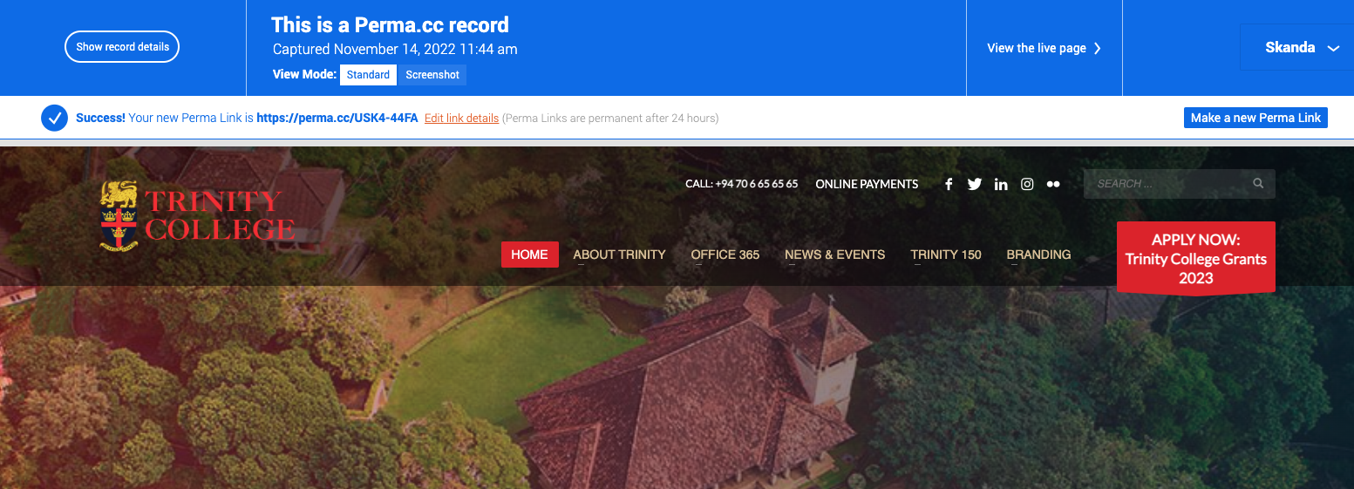
Capturing a web page via Perma.cc
Go to https://perma.cc
Create an account
https://perma.cc/sign-up
Capture a web page
https://perma.cc/USK4-44FA

Slide 46
Memento response headers are not present for recently archived pages in Perma.cc
skandasiva@Skandas-MBP-2 ~ % curl -Ik https://perma.cc/7TVJ-PMF7
HTTP/2 200
date: Mon, 14 Nov 2022 19:05:24 GMT
content-type: text/html; charset=utf-8
memento-datetime: Sun, 29 Apr 2018 18:24:10 GMT
link: <https://twitter.com/zittrain/status/990648288918626304>; rel=original, <https://perma.cc/timegate/https://twitter.com/zittrain/status/990648288918626304>; rel=timegate, <https://perma.cc/timemap/link/https://twitter.com/zittrain/status/990648288918626304>; rel=timemap; type=application/link-format, <https://perma.cc/timemap/json/https://twitter.com/zittrain/status/990648288918626304>; rel=timemap; type=application/json, <https://perma.cc/timemap/html/https://twitter.com/zittrain/status/990648288918626304>; rel=timemap; type=text/html, <https://perma.cc/7TVJ-PMF7>; rel=memento; datetime="Sun, 29 Apr 2018 18:24:10 GMT"
…..
Replayed time
skandasiva@Skandas-MBP-2 ~ % curl -Ik https://perma.cc/USK4-44FA
HTTP/2 200
date: Mon, 14 Nov 2022 19:06:14 GMT
content-type: text/html; charset=utf-8
cache-control: no-cache, no-store, must-revalidate, max-age=3600
x-frame-options: DENY
vary: Cookie, Host
strict-transport-security: max-age=15768000
cf-cache-status: DYNAMIC
set-cookie: __cflb=0H28vJJdLkHc3TMWQs8NpGqxR3qyeRcjz6g6pzjgmrc; SameSite=None; Secure; path=/; expires=Tue, 15-Nov-22 18:06:14 GMT; HttpOnly
server: cloudflare
cf-ray: 76a205ef6f0774a3-IAD
Archived time
Live web URL
My highschool webpage archived in Perma.cc today
A twitter post archived in Perma.cc in 2018
https://www.rfc-editor.org/info/rfc7089

Slide 47
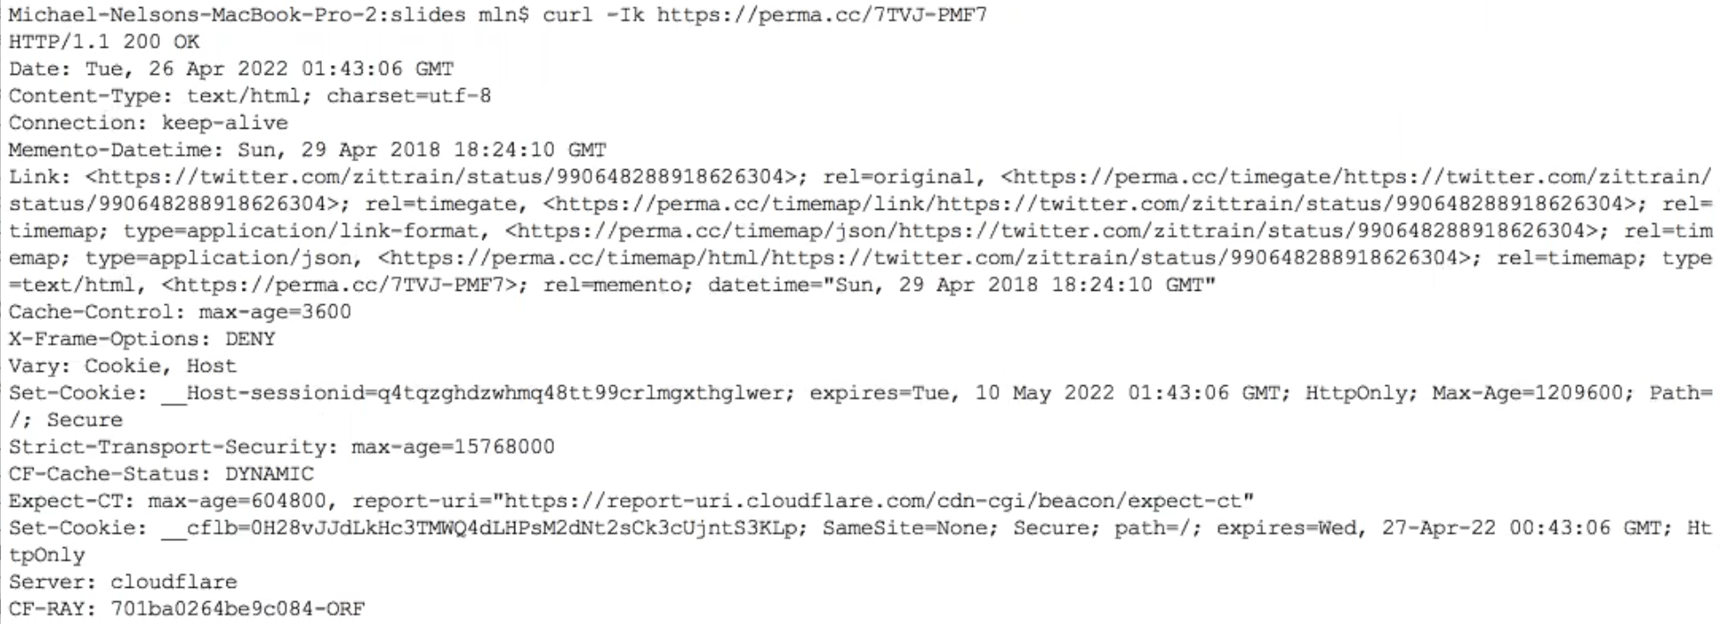
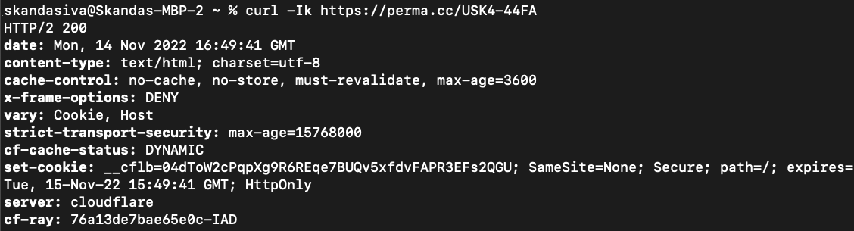
curl does not give much insight now than in the past
Replayed time
Archived time

Slide 48
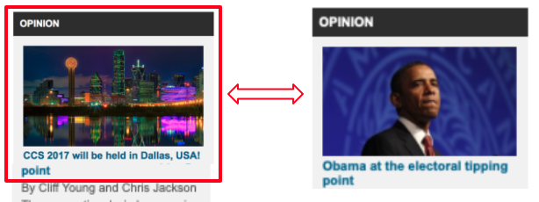
Live web leakage on playback
Javascript can send messages to evil.com and fetch new content.
Attack #1: Archival Escapes/Zombies
Mitigation:
Content-Security-Policy header
https://content-security-policy.com/

Slide 49
Show different page contents when archived: Cloaking
Showing different content depending on who is asking
Live web shows something, archive shows something else
If the page knows it is going to be in archive, they can do dynamically constructed URLs which would
Similar to Attack #3: “Same-Origin Escape” + “Archive-Escape Abuse”
Mitigation:
Run archive in containerized/proxy mode browser

Slide 50
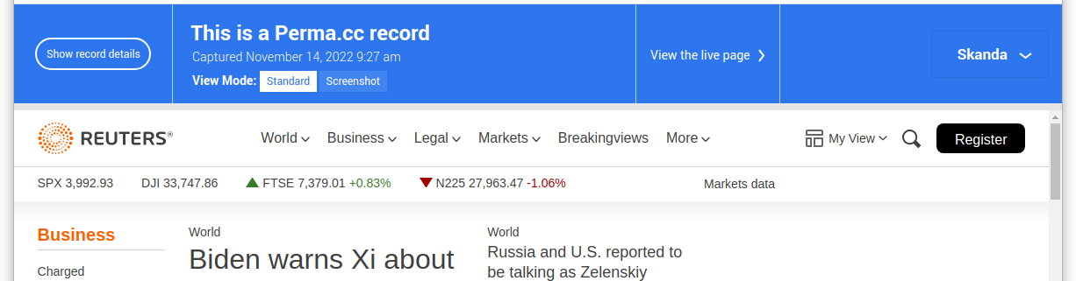
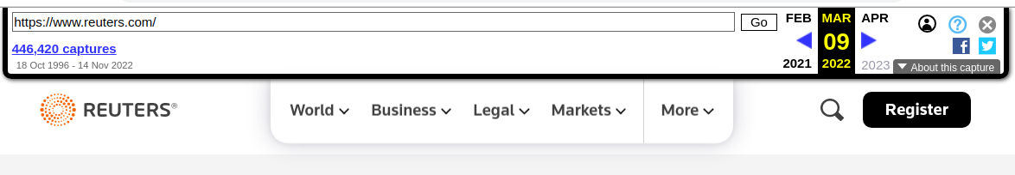
Banner Spoofing
Pages can dynamically edit the archive's banner.
https://perma.cc/UZL6-PVLU
https://web.archive.org/web/20220309000639/https://www.reuters.com/
Mitigation:
Use iframes for replay
Don't inject banner into replay frame
Use X-Frame-Options header to limit embedding
Serve from separate content domain
Use iframe sandbox (more restrictive)
Run archive in containerized/proxy mode browser

Slide 51
Comparison between the two studies
Rewriting history: Changing the archived web from the present
Explains the motivation to why the archives are manipulated and proposes vulnerability attacks without compromising the archives or servers
Thinking like a hacker: Security Considerations for High-Fidelity Web Archives
Explains why security is a concern and exploits the vulnerabilities to demonstrate the threats
Similar attacks are explored under different names
# | Rewriting history | Thinking like a hacker
1 | Attack #1: Archival escape | Live web leakage on playback
2 | Attack #3: “Same-Origin Escape” + “Archive-Escape Abuse” | Show different page contents when archived: Cloaking

Slide 52
Key Takeaways
Web archives used extensively in journalism, citations and legal proceedings
Motivation to be negatively manipulated
Attacks can manipulate how clients see archived websites
Without compromising the archive’s or any other servers
Vulnerabilities enabling the attacks are entirely ordinary interaction with archives
Accidental inaccuracies → Intentional accuracies
70% of investigates sites were vulnerable to at least one type of attack
Website publishers, archive designers and end users should take steps to prevent/detect intentional manipulations
Vulnerabilities reported to the Internet Archive and remedied
Deployed CSP headers: blocked archive-escape requests

